Slide 1
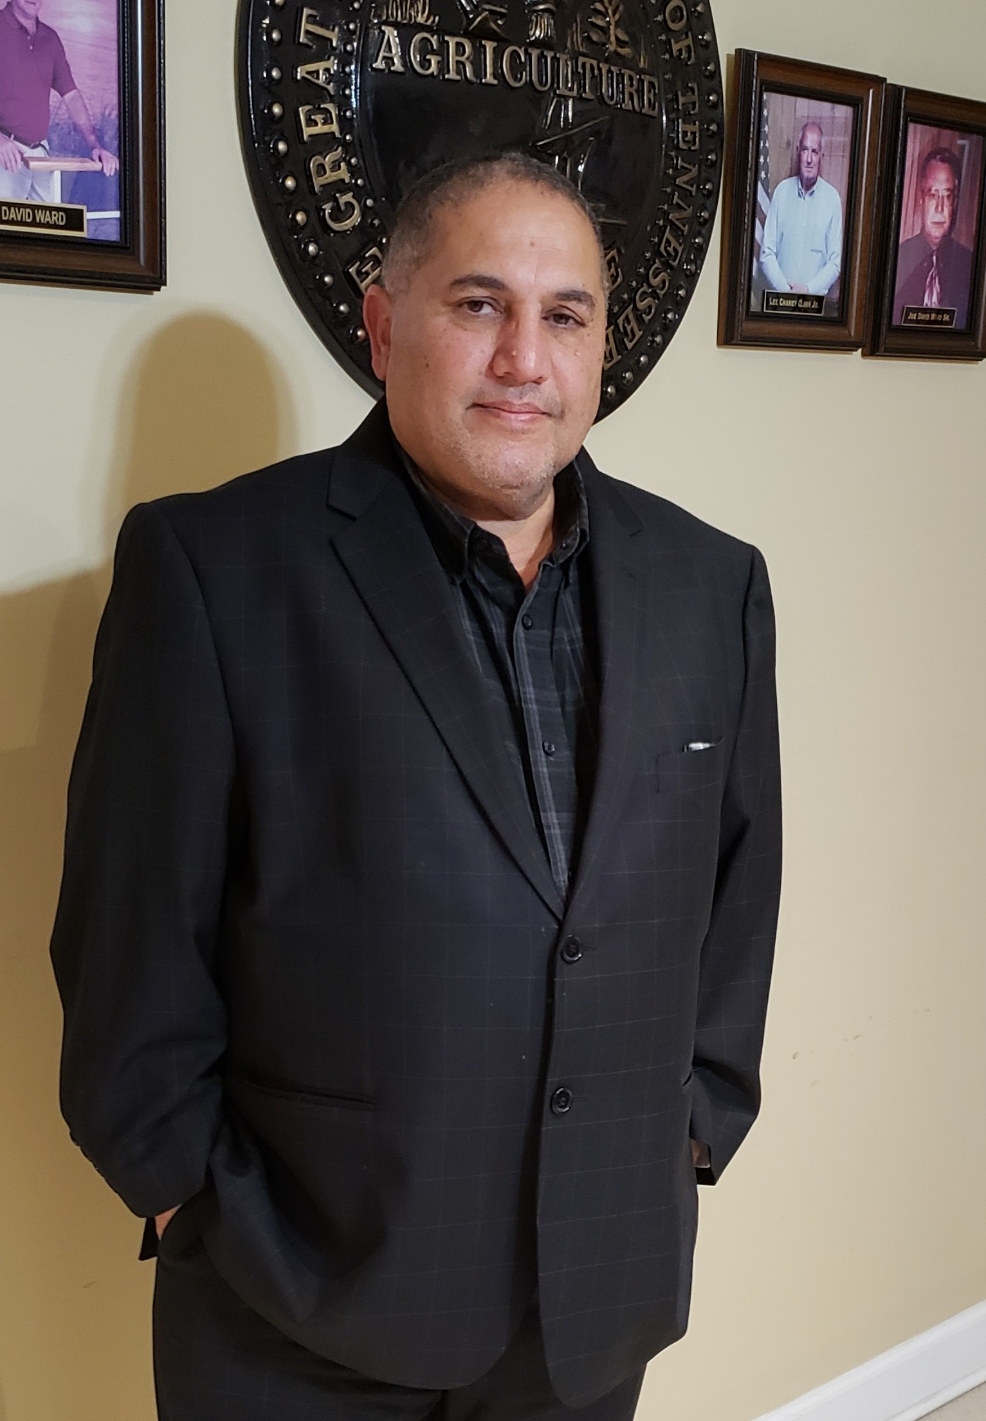
Town of Mason
State of the Town
The Town of Mason’s Mayor Eddie Noeman, will address the Constituents on the State of the Town. During the meeting, the Mayor will update the Constituents on town’s status. The meeting will be on Facebook Live. Please ensure that you logon to the Town’s Facebook Page at Town of Mason 2024.
Location: Facebook Live
Date: 01/04/2025
Time: 1:00PM CST

